Slide 1
Special functions and Integral Transforms MAT 241
انقر لإضافة نص
Dr. Mohamed Adel
mohamed.adel@aiet.edu.eg

Slide 2
Lecture(9): Legendre Polynomials

Slide 3

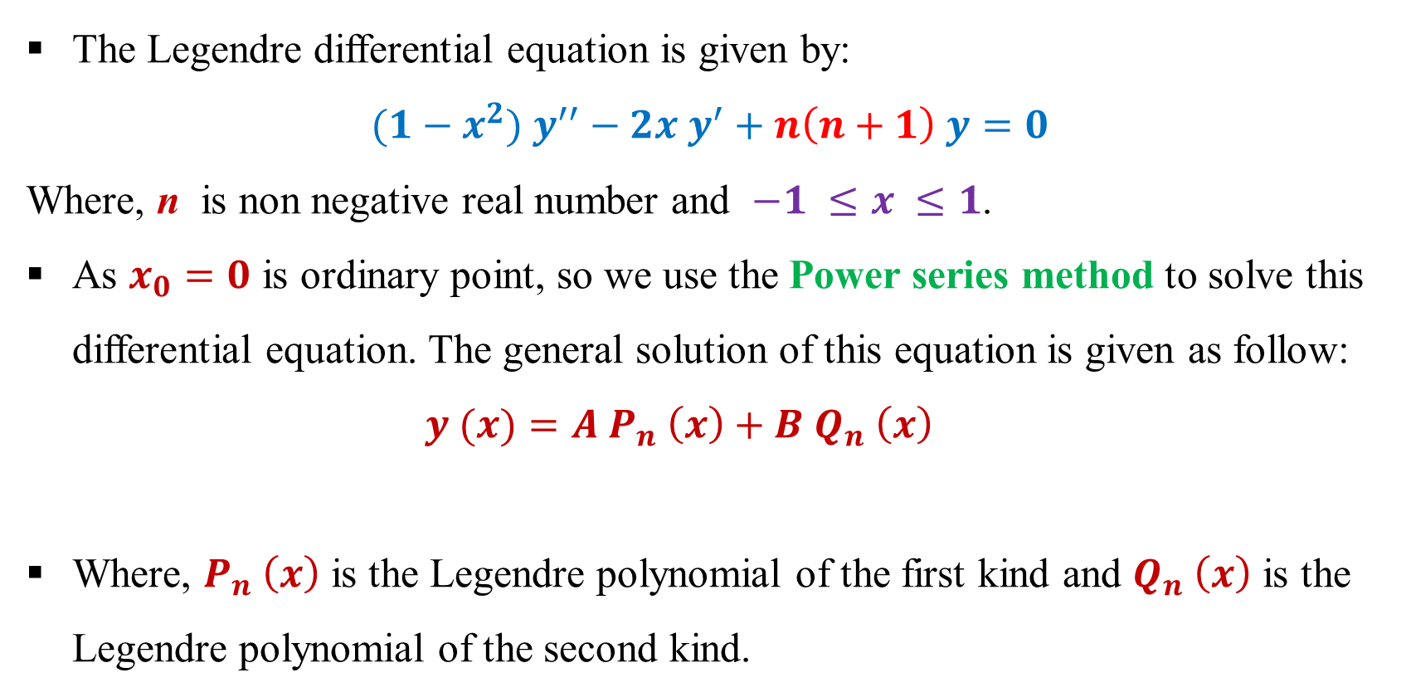
Legendre Polynomials
The Legendre differential equation is given by:
$${(1−x}^{2}) y^{′′}−2x y^{′}+n\left(n+1\right) y=0$$
Where, n is non negative real number and $−1 ≤x ≤1$.
As $x_{0}=0$ is ordinary point, so we use the Power series method to solve this differential equation. The general solution of this equation is given as follow:
$$y (x)=A P_{n} \left(x\right)+B Q_{n} \left(x\right)$$
Where, $P_{n} \left(x\right)$ is the Legendre polynomial of the first kind and $Q_{n} \left(x\right)$ is the Legendre polynomial of the second kind.

Slide 4
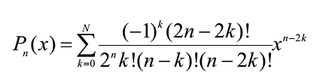
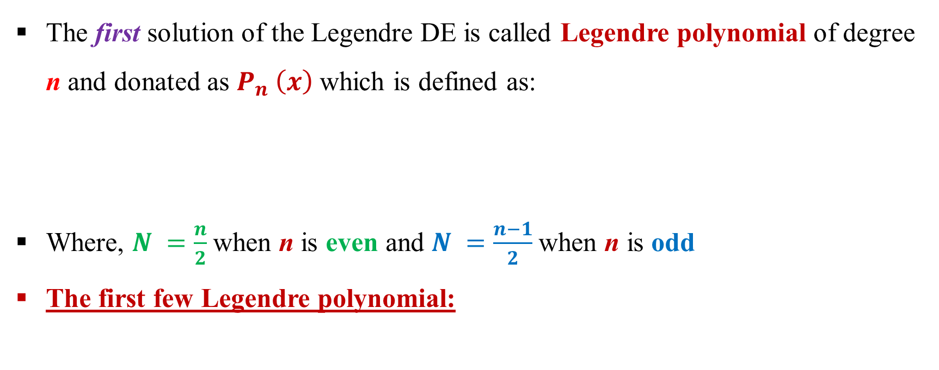
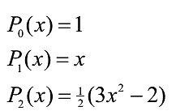
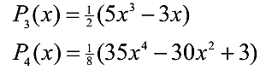
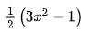
Legendre Polynomial
The first solution of the Legendre DE is called Legendre polynomial of degree n and donated as $P_{n} \left(x\right)$ which is defined as:
Where, $N =\frac{n}{2}$when n is even and $N =\frac{n−1}{2}$when n is odd
The first few Legendre polynomial:

Slide 5
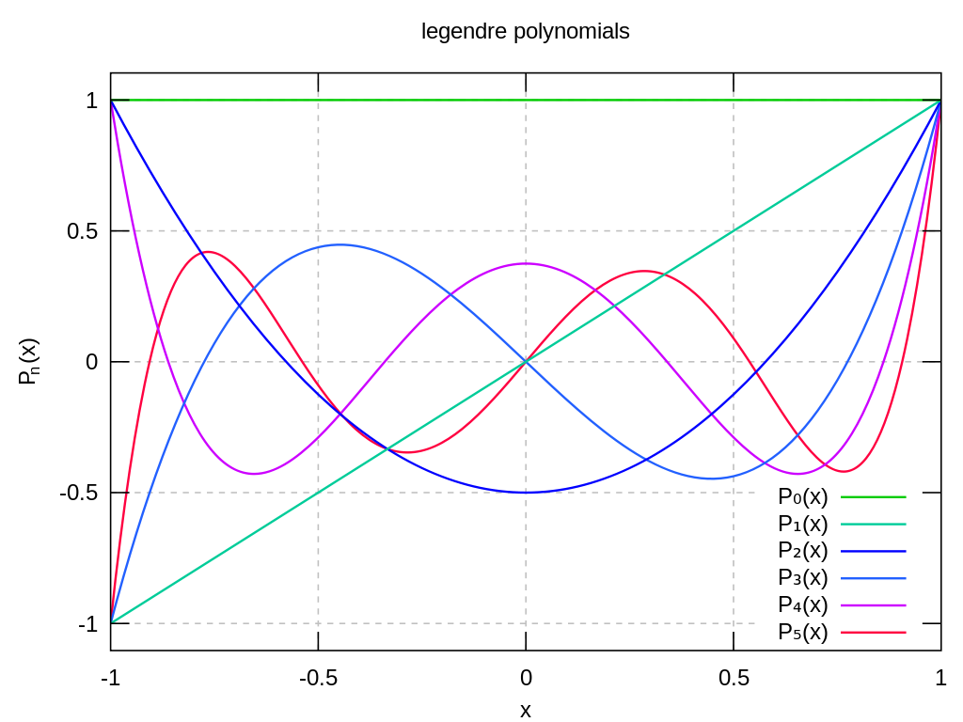

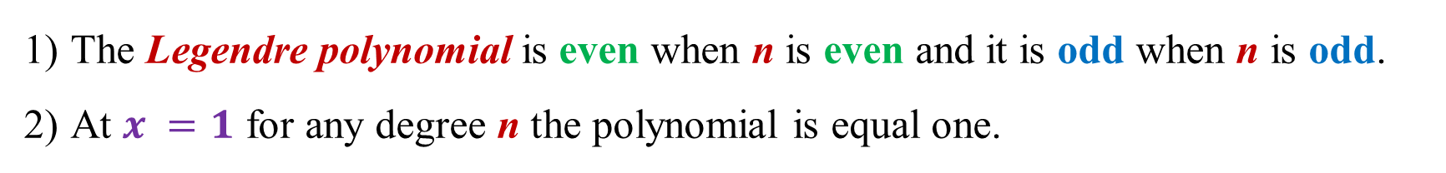
The Legendre polynomial is even when n is even and it is odd when n is odd.
At $x =1$ for any degree n the polynomial is equal one.
$$P_{n}\left(1\right)=1$$

Slide 6
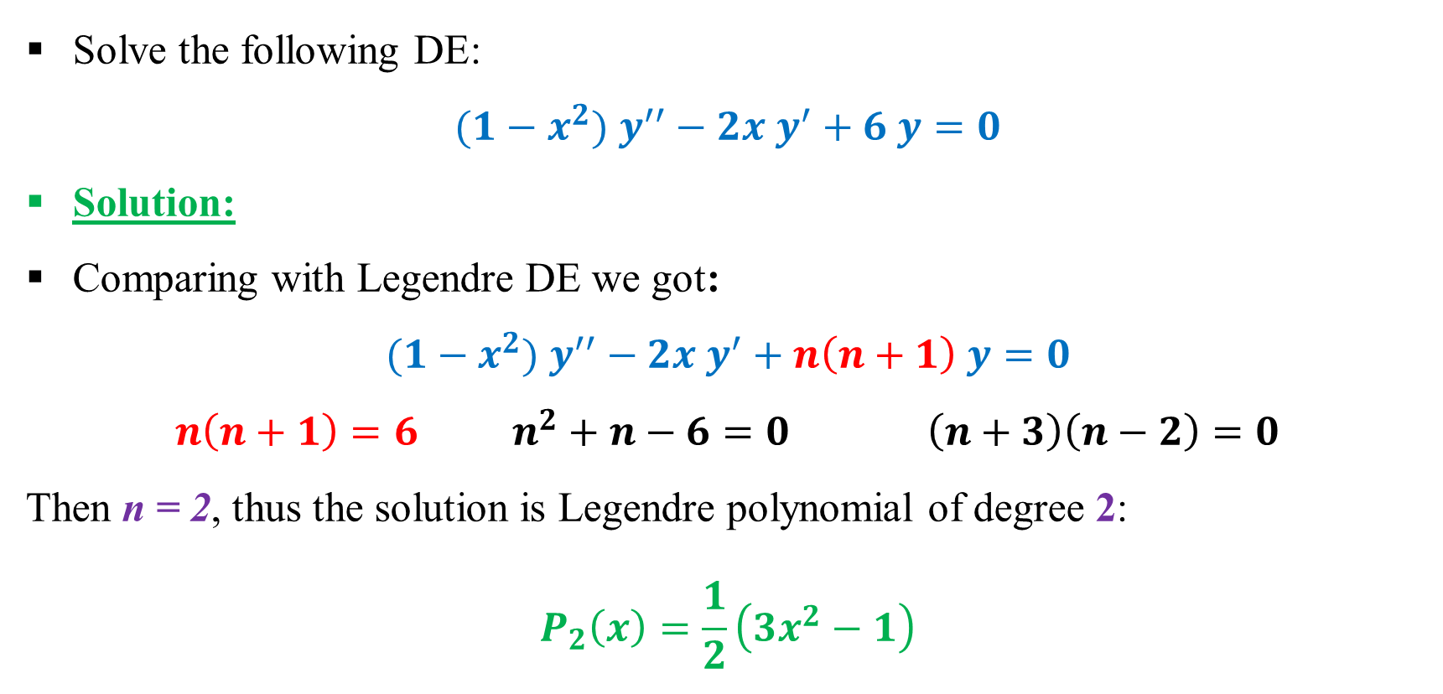
Example:
Solve the following DE:
$${(1−x}^{2}) y^{′′}−2x y^{′}+6 y=0$$
Solution:
Comparing with Legendre DE we got:
$${(1−x}^{2}) y^{′′}−2x y^{′}+n\left(n+1\right) y=0$$
$n\left(n+1\right)=6$ $n^{2}+n−6=0$ $\left(n+3\right)\left(n−2\right)=0$
Then n = 2, thus the solution is Legendre polynomial of degree 2:
$$P_{2}\left(x\right)=\frac{1}{2}\left(3x^{2}−1\right)$$

Slide 7
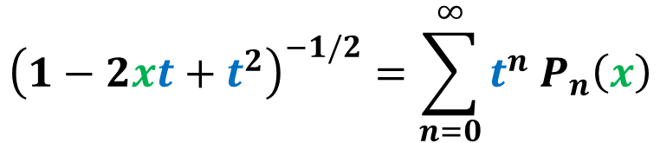
Generating function for Legendre Polynomial
$${\left(1−2xt+t^{2}\right)}^{−1/2}=\sum_{n=0}^{∞}{t^{n} P_{n}\left(x\right)}$$
$${\left(1−2xt+t^{2}\right)}^{−1/2}=t^{0} P_{0}\left(x\right)+t^{1} P_{1}\left(x\right)+t^{2} P_{2}\left(x\right)+ …$$
Where, $−1 ≤x ≤1$ and $−1 <t <1$

Slide 8
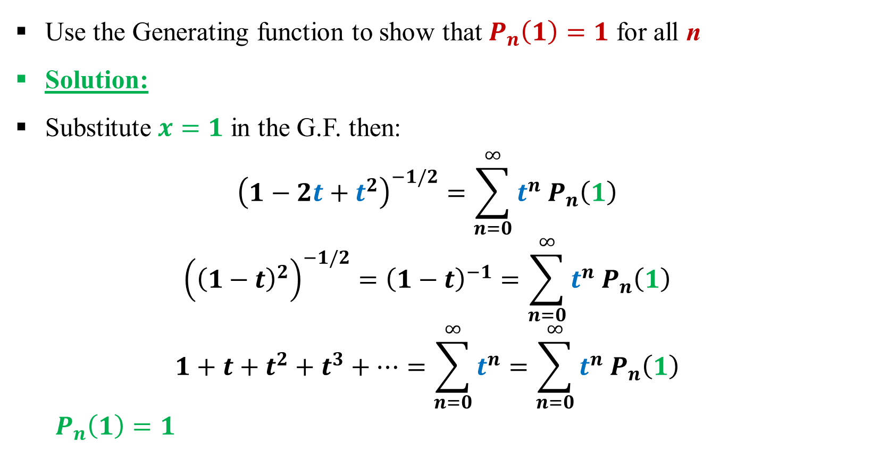
Example:
Use the Generating function to show that $P_{n}\left(1\right)=1$ for all n
Solution:
Substitute $x=1$ in the G.F. then:
$${\left(1−2t+t^{2}\right)}^{−1/2}=\sum_{n=0}^{∞}{t^{n} P_{n}\left(1\right)}$$
$${\left({\left(1−t\right)}^{2}\right)}^{−1/2}={\left(1−t\right)}^{−1}=\sum_{n=0}^{∞}{t^{n} P_{n}\left(1\right)}$$
$$1+t+t^{2}+t^{3}+…=\sum_{n=0}^{∞}{t^{n}}=\sum_{n=0}^{∞}{t^{n} P_{n}\left(1\right)}$$
$P_{n}\left(1\right)=1$

Slide 9
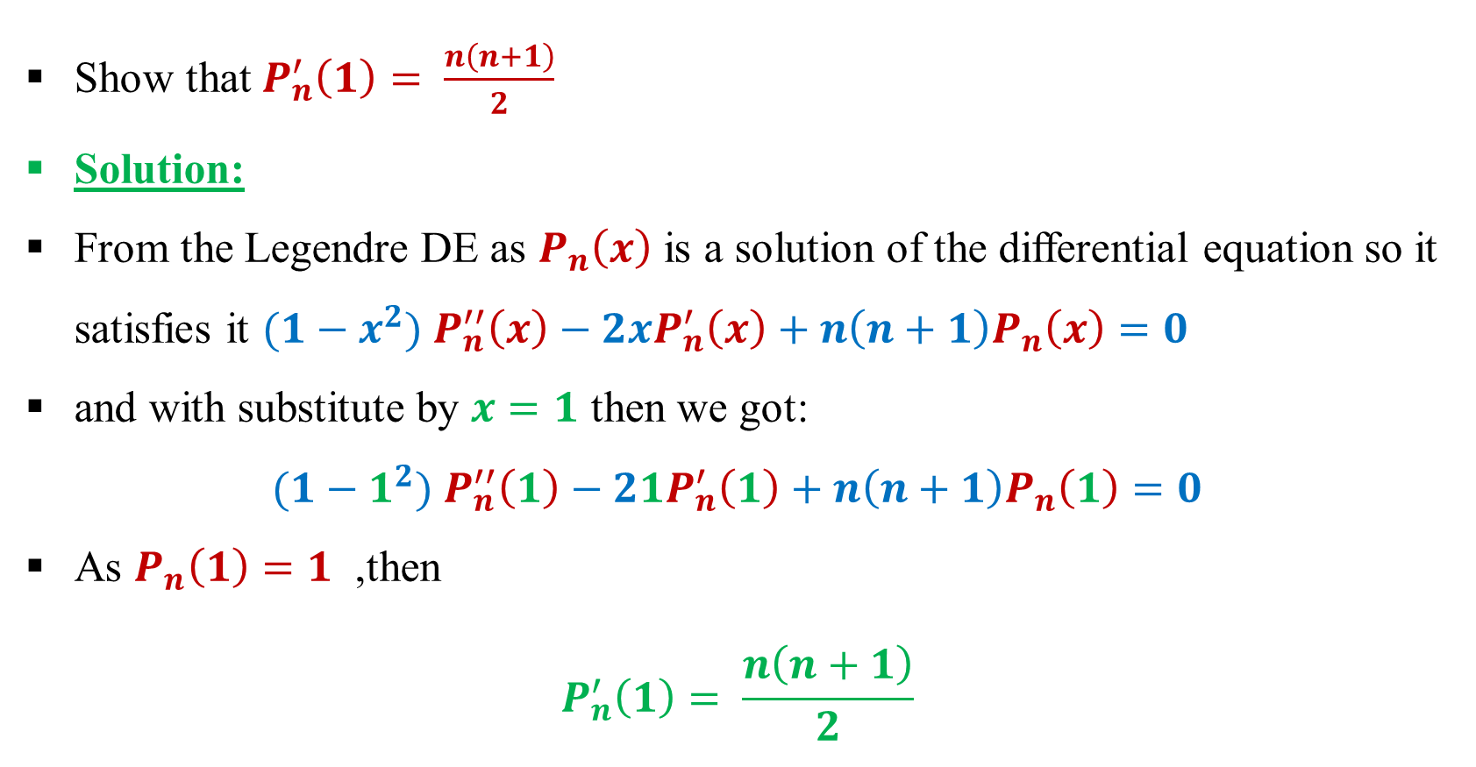
Example:
Show that $P_{n}^{′}\left(1\right)= \frac{n\left(n+1\right)}{2}$
Solution:
From the Legendre DE as $P_{n}\left(x\right)$ is a solution of the differential equation so it satisfies it ${(1−x}^{2}) P_{n}^{′′}\left(x\right)−2xP_{n}^{′}\left(x\right)+n\left(n+1\right)P_{n}\left(x\right)=0$
and with substitute by $x=1$ then we got:
$${(1−1}^{2}) P_{n}^{′′}\left(1\right)−21P_{n}^{′}\left(1\right)+n\left(n+1\right)P_{n}\left(1\right)=0$$
As $P_{n}\left(1\right)=1$ ,then
$$P_{n}^{′}\left(1\right)= \frac{n\left(n+1\right)}{2}$$

Slide 10
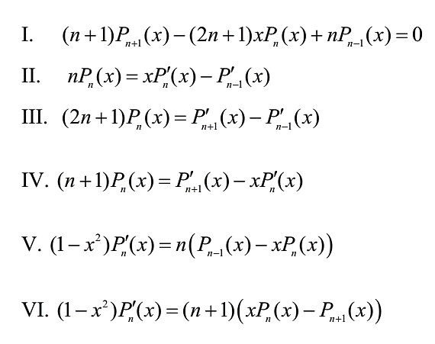
Recurrence Relations for Legendre polynomials

Slide 11
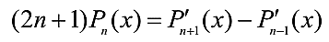
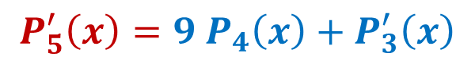
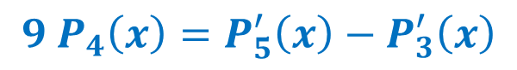
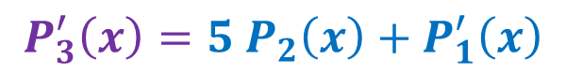
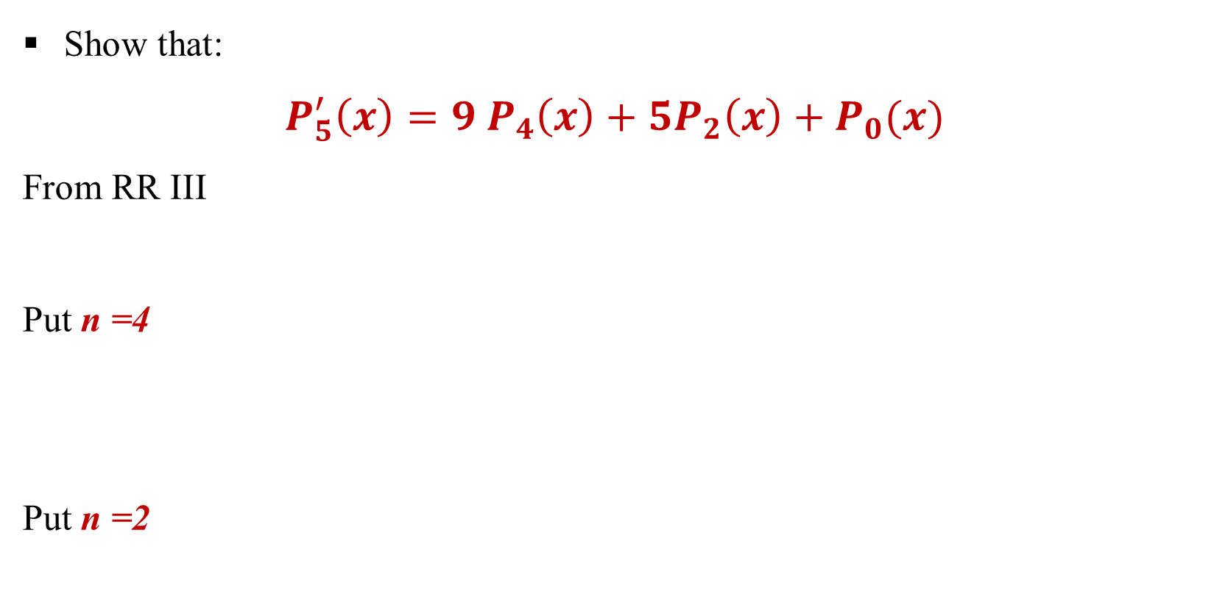
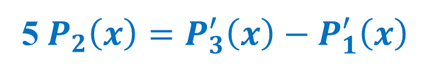
Example:
Show that:
$$P_{5}^{′}\left(x\right)=9 P_{4}\left(x\right)+5P_{2}\left(x\right)+P_{0}(x)$$
From RR III
Put n =4
Put n =2
$$9 P_{4}\left(x\right)=P_{5}^{′}\left(x\right)−P_{3}^{′}\left(x\right)$$
$$P_{5}^{′}\left(x\right)=9 P_{4}\left(x\right)+P_{3}^{′}\left(x\right)$$
5$P_{2}\left(x\right)=P_{3}^{′}\left(x\right)−P_{1}^{′}\left(x\right)$
$$P_{3}^{′}\left(x\right)=5 P_{2}\left(x\right)+P_{1}^{′}\left(x\right)$$

Slide 12
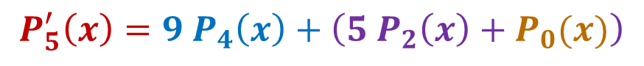
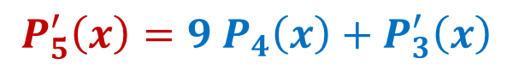
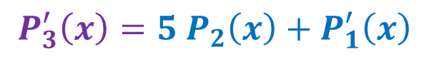
$$P_{5}^{′}\left(x\right)=9 P_{4}\left(x\right)+P_{3}^{′}\left(x\right)$$
$$P_{3}^{′}\left(x\right)=5 P_{2}\left(x\right)+P_{1}^{′}\left(x\right)$$
$$P_{5}^{′}\left(x\right)=9 P_{4}\left(x\right)+\left(5 P_{2}\left(x\right)+P_{1}^{′}\left(x\right)\right)$$
$$P_{1}\left(x\right)=x → P_{1}^{′}\left(x\right)=1= P_{0}(x)$$
$$P_{5}^{′}\left(x\right)=9 P_{4}\left(x\right)+\left(5 P_{2}\left(x\right)+P_{0}(x)\right)$$

Slide 13
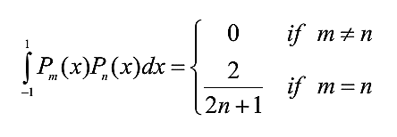
Orthogonal properties of Legendre polynomials
The most important property of Legendre polynomials is the orthogonality property. This given by:

Slide 14
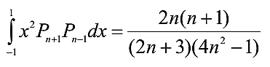
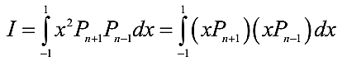
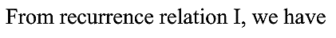
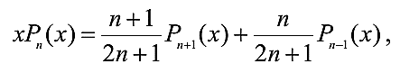
Example:
Show that:
Solution:

Slide 15
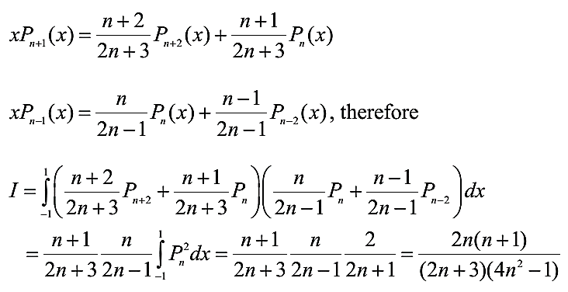

Slide 16
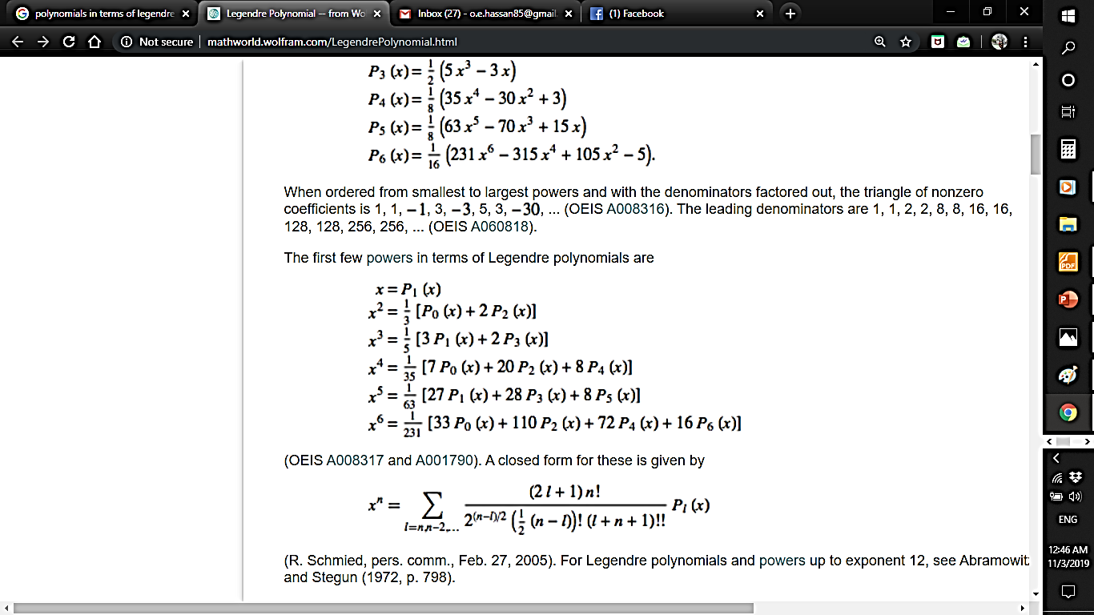
Note:
Any polynomial of degree n can be represented in terms of Legendre polynomials

Slide 17
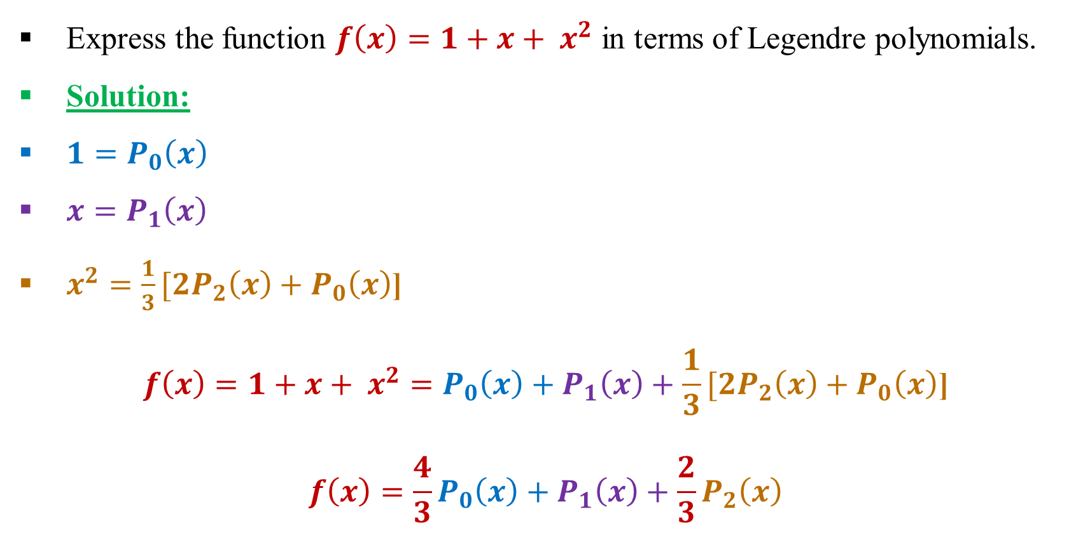
Example
Express the function $f\left(x\right)=1+x+ x^{2}$ in terms of Legendre polynomials.
Solution:
$1=P_{0}\left(x\right)$
$x=P_{1}\left(x\right)$
$x^{2}=\frac{1}{3}[2P_{2}\left(x\right)+P_{0}\left(x\right)$]
$$f\left(x\right)=1+x+ x^{2}=P_{0}\left(x\right)+P_{1}\left(x\right)+\frac{1}{3}[2P_{2}\left(x\right)+P_{0}\left(x\right)\text{]}$$
$$f\left(x\right)=\frac{4}{3}P_{0}\left(x\right)+P_{1}\left(x\right)+\frac{2}{3}P_{2}\left(x\right)$$

Slide 18
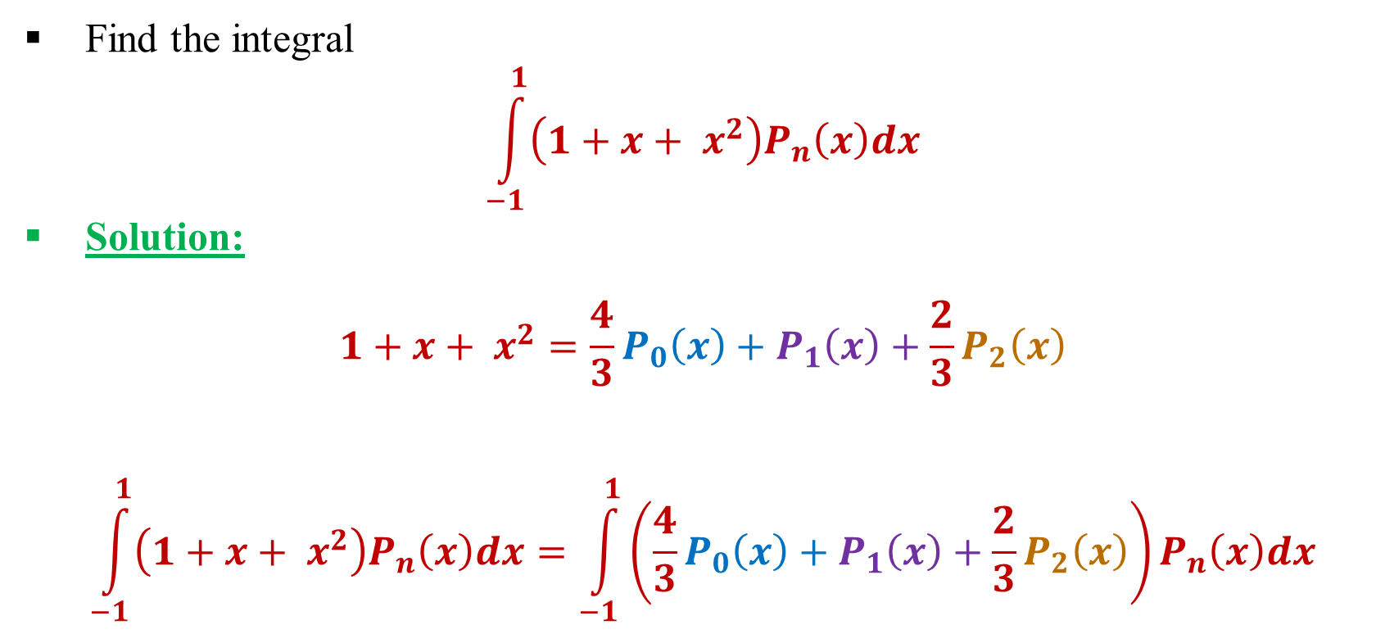
Example
Find the integral
$$\int_{−1}^{1}{\left(1+x+ x^{2}\right)P_{n}\left(x\right)dx}$$
Solution:
$$1+x+ x^{2}=\frac{4}{3}P_{0}\left(x\right)+P_{1}\left(x\right)+\frac{2}{3}P_{2}\left(x\right)$$
$$\int_{−1}^{1}{\left(1+x+ x^{2}\right)P_{n}\left(x\right)dx}=\int_{−1}^{1}{\left(\frac{4}{3}P_{0}\left(x\right)+P_{1}\left(x\right)+\frac{2}{3}P_{2}\left(x\right)\right)P_{n}\left(x\right)dx}$$

Slide 19
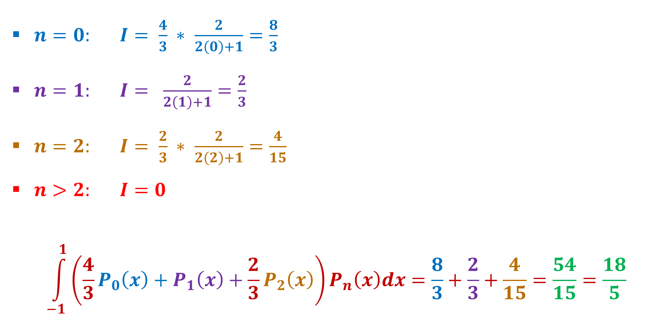
$n=0: I= \frac{4}{3} ∗ \frac{2}{2\left(0\right)+1}=\frac{8}{3}$
$n=1: I= \frac{2}{2\left(1\right)+1}=\frac{2}{3}$
$n=2: I= \frac{2}{3} ∗ \frac{2}{2\left(2\right)+1}=\frac{4}{15}$
$n>2: I=0$
$$\int_{−1}^{1}{\left(\frac{4}{3}P_{0}\left(x\right)+P_{1}\left(x\right)+\frac{2}{3}P_{2}\left(x\right)\right)P_{n}\left(x\right)dx}=\frac{8}{3}+\frac{2}{3}+\frac{4}{15}=\frac{54}{15}=\frac{18}{5}$$

Slide 20
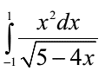
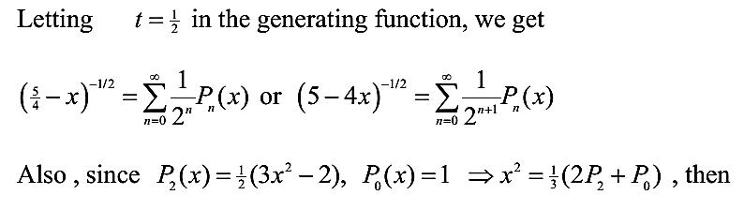
Example:
Evaluate the following integral:
Solution:

Slide 21
